Slide 1
Jess’s Top Social Media Tips

Slide 2
Hello …
Jessica Taylor (Jess)
Digital Marketing Officer for the university
Part of the Webteam
Call: 01463 2(79236)
Email: Jessica.taylor@uhi.ac.uk

Slide 3
Develop and manage social media content:

Slide 4
Firstly…
Social platforms:
Help us connect with prospective students, students, staff and alumni
Increase awareness about the university, our course offerings and research
Allow us to tell our story in our own words – no corporate jargon required!
Allows us to build on the university brand
Notes:
More and more students turn to social media in order to inform their school choice for college and university.
Social media offers a perfect platform to keep students and alumni engaged with the school—even after they’ve graduated.
This establishes your school as more than just a school. It’s also a community where people develop deep, life-long connections with one another.
Platforms like Instagram give prospective students the opportunity to see what life is like at different schools—from the residence halls, to classes, to celebrations, and outdoor strolling spaces.
Remember – the university is a brand. Like any brand, you want to show off your best angles. Social media provides a great way to showcase everything wonderful about the university.

Slide 5
Time is your biggest enemy
Notes:
Searching, creating and uploading content for social media takes time.
Imagine this is your shop front and you are trying to demonstrate what you offer and why, you’re also trying to entice people in.
You also need to factor in time to reply to queries – both on your posts and via messenger.
This is not a 5 minute job that you can do at 4.50pm before you head home…it needs dedicated time in your schedule, even better if it’s included in your PDR so that there’s an understanding that this is a core part of your job.
With all of this in mind, ask yourself these questions:
Do you have time to properly dedicate to this?
If so, can you manage more than one social media platform? It’s better to manage one well than struggle to manage multiple platforms which differing needs
Is there support for you if you are away for extended periods of time?

Slide 6
With more than three billion people around the world using social media every month, it’s no passing trend.

Slide 7
How much time do people spend on Social Media?
Source: www.oberlo.co.uk/blog/social-media-marketing-statistics

Slide 8
The Power of Social Media Marketing
Source: www.oberlo.co.uk/blog/social-media-marketing-statistics

Slide 9
Choosing social media platforms
Social media is among the most effective marketing methods that we have at our disposal.
However, not all social media channels are created the same.
Each platform has its particular set of users with their own quirks as to how they interact with content.

Slide 10
Which ones should I choose?
Notes:
The top three social media platforms for the university:
Facebook - attracts a slightly older market with our most popular demographic aged between 25-34, his ties in with the creation of the platform in 2004. It’s often a great place to engage with mature students, alumni, parents and carers. Don’t forget that school-leavers are often influenced by their parents/carers when making a decision on which university to go to so getting them on side too is just as important. Facebook is also the best for:
Sharing events such as open days, seminars etc
Engaging with people via messenger
Targeting users through paid-for content.
Instagram - The biggest demographic group on Instagram is 18-24 year olds, many younger users like this platform better as their parents/carers are already on Facebook. There’s also more creative options such as stories and filters (whilst Facebook has added these in more recent years it’s more advanced on Instagram). Instagram is best for:
Engaging with final-year school pupils who are looking at their university options
Engaging with younger students
Sharing campus and student images which help build up a picture of student life.
Twitter - The largest demographic of Twitter users is 18-29 year olds (37%). 25% of users are aged 30-49. We find the most effective engagement for the university’s Twitter presence is:
Research staff and students
Other organisations – including HE institutions and schools
Postgraduate students and alumni
Public figures, politicians and MP’s.
We also use YouTube and Flickr for the external storage of high quality video and photo content – these can then be shared on social media platforms and web content.
Another one to consider as a professional working in Higher Education is LinkedIn, it can be a great way to share university news, research and funding opportunities with your peers.
Other social media platforms used by universities include Snapchat, TikTok and WhatsApp. Whilst we do keep up to date with their development we believe content for these social media platforms needs to be created by students themselves, this is something we plan to look into more in the future.

Slide 11
Top tips for creating content

Slide 12
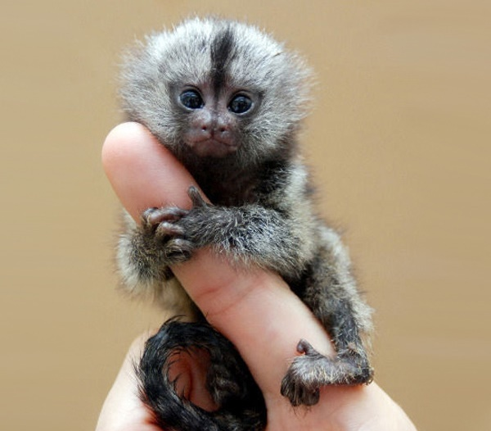
Keep it short and sweet
Notes:
Shorter posts usually receive more likes, comments, and shares on Facebook. People like when a message makes its point quickly and concisely. It’s satisfying. Use web links to offer more information, users will click on them if they want to know more.
Posts with 80 characters or less receive 66% HIGHER engagement.
If a user has click to ‘see more’ on your post it’s probably too long – the exception is when you need to give important information, such as exam result notifications.
Twitter restricts posts to 280 characters - this means you must work even harder to compose short and interesting posts which get your main point across.
Don’t forget - if users want to know more information they will ask, this can encourage two-way engagement.

Slide 13
Use links for more information
Notes:
As Twitter limits characters it’s important to use shortened web links, we use Bitly to create ours but there are many out there you can try.
By providing links it instantly improves user interactivity by allowing them to click through to find more information and then they can comment on your post, ask questions…or re-Tweet/share on Facebook.
Links don’t work on Instagram posts so it’s better to add them to your bio – just remember to update the link in the bio if it’s no longer relevant.
Just a word of caution – check the links work and that the content is suitable for your audience.
A link we were sent of one of our art student’s websites took us to a homepage which showed nude-self portraits – definitely not suitable for us to share!

Slide 14
Search and use hashtags
#hashtag
Notes:
Hashtags are more commonly used on Twitter and Instagram, but these have now been adopted on Facebook too so don’t forget to try them on all three platforms.
Check if there are any hashtags you can add to your posts - especially if it is a popular trending topic or a national event that you can piggyback on to.
Try and always use the university’s hashtag as it appears on our social media wall on our website which is accessible from the homepage and in sections for prospective and current students.

Slide 15
Notes:
Source: www.uhi.ac.uk/en/studying-at-uhi/student-life

Slide 16
Don’t talk in the third person
In 2020 the University of the Highlands and Islands will be offering a graduate placement through the Ambitious Futures Graduate Training Programme…
In 2020 we will be offering a graduate placement through the Ambitious Futures Graduate Training Programme…
Notes:
Make sure you communicate in your own voice – the user will know so you don’t need to include your organisation’s name.
Whilst you must remain professional representing your organisation you should try and come across personable and find your own voice.
You are not writing a formal document, remember people often go on social media for entertainment or interesting news stories.

Slide 17
Interact with your audience
Notes:
Social media is very handy as it allows us to have direct interaction with an audience.
Therefore you need to be answering queries that are put to you as soon as you can.
If you don’t know the answer to a question let the user know that and that’ll you’ll post an update once you do.
This makes you as an organisation, and your research much more accessible.
Social networking functions to encourage a conversation between you and your audience meaning it is important for you not just talk at the audience, but to talk to them.
Invite readers of your posts to participate in a two-way conversation.

Slide 18
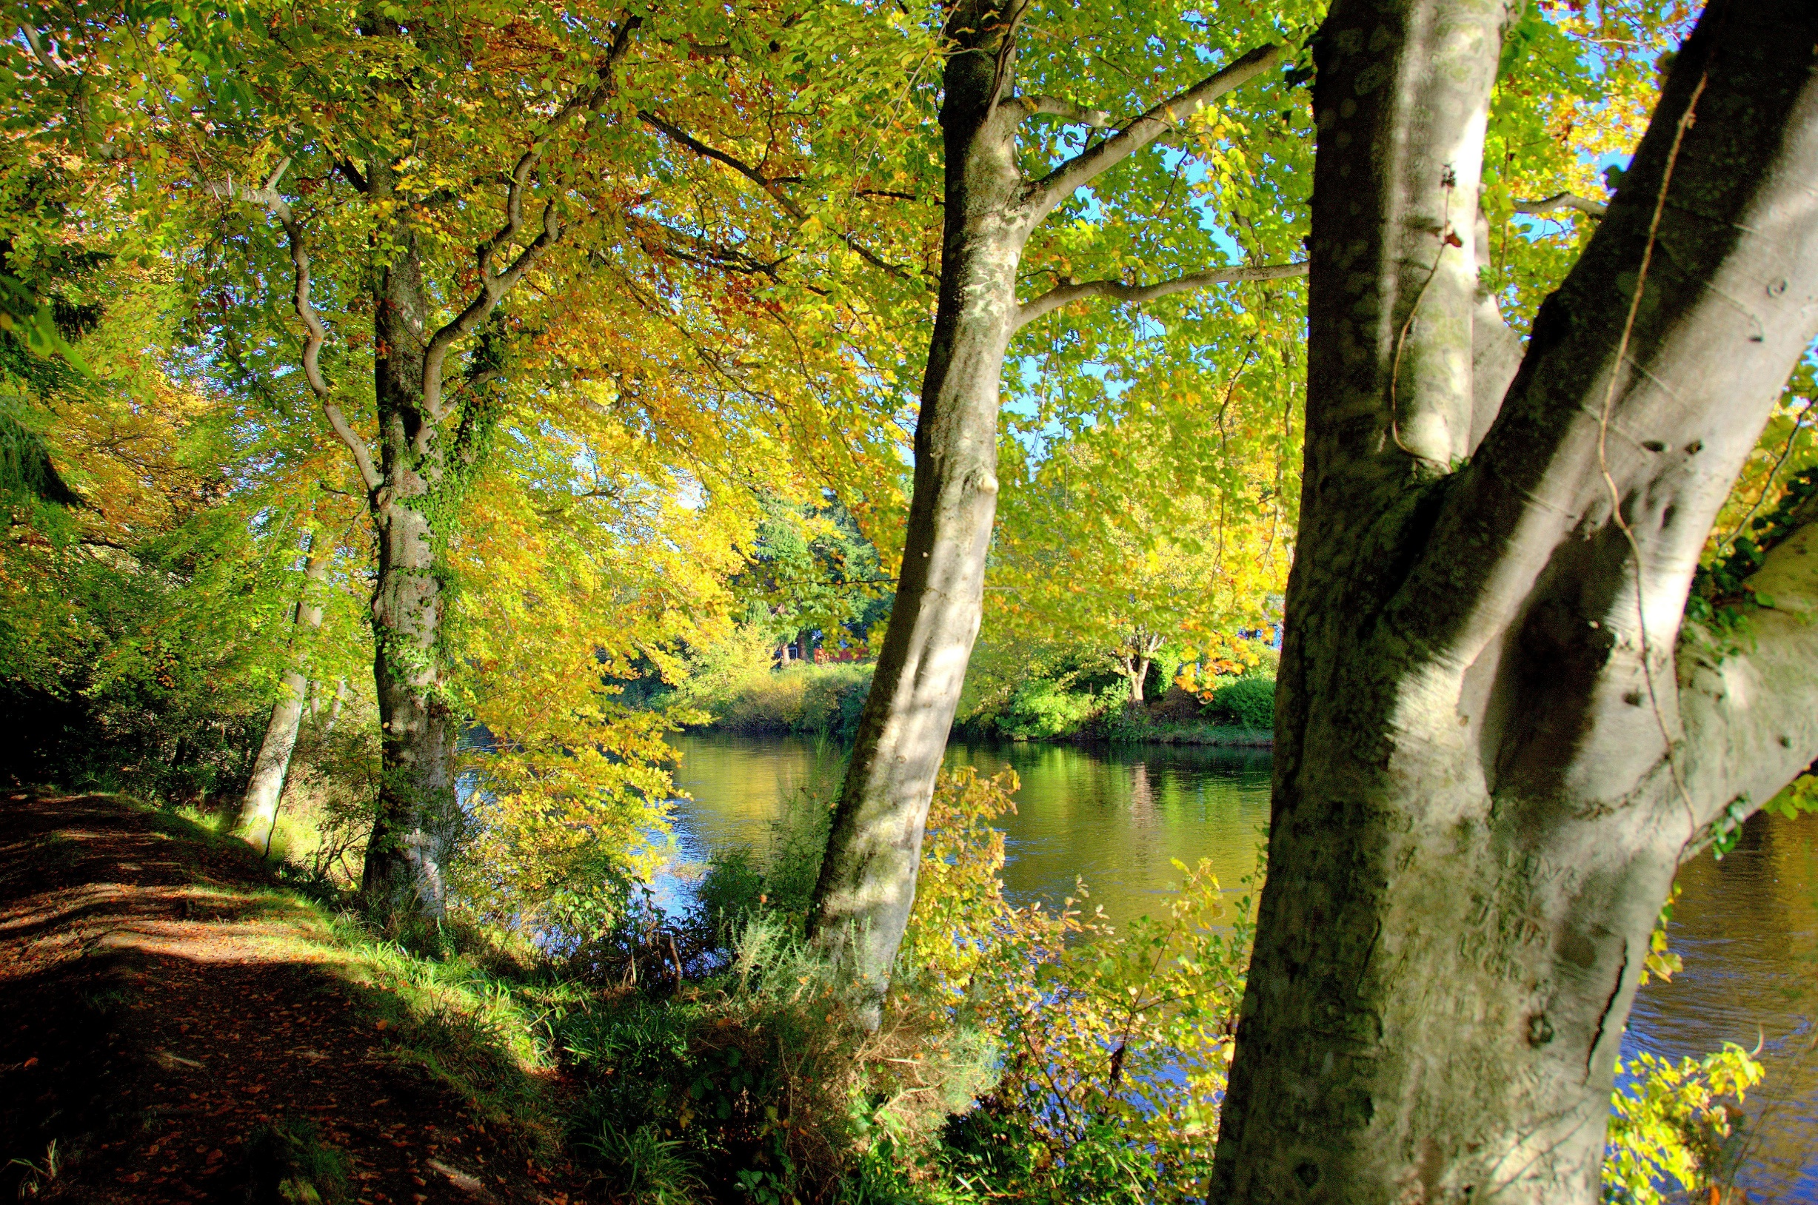
Acknowledge others
Notes:
A really simple one – but remember to respect copyrights and ensure you have the right to use photos/videos/text/music etc.
This beautiful autumn picture taken at Ness Islands in Inverness was sourced on Flickr.
We asked the photographer for permission; we then starred his photo via the university’s Flickr account and gave him a mention in our post.
The upside of this good practice is you get to catch their audiences too by tagging them in your social media posts bringing you an even wider reach.
When you’re sharing social media content you don’t need to ask for permission but you should always credit the source.

Slide 19
Choose a striking cover
Notes:
University social media accounts should be using the university’s logo as their profile image – this easily identifies your account as being linked to the university.
You have the opportunity to personalise your Facebook and Twitter page’s cover – this is your opportunity to use striking imagery which you feel represents the university, your research or your service offering.
Another option is to change your covers with the seasons and/or event - Just remember to change these as soon as the dates have passed!
Try to keep text in your cover images to a minimum as it may appear cropped on different devices (mobile, tablet etc.).

Slide 20
Why text in a banner image doesn’t always work
What you see on your desktop or laptop:
Notes:
You’ve uploaded your new cover image and you’ve check it on your desktop or laptop and it all looks great, you can see all of the text and it’s all aligned nicely…

Slide 21
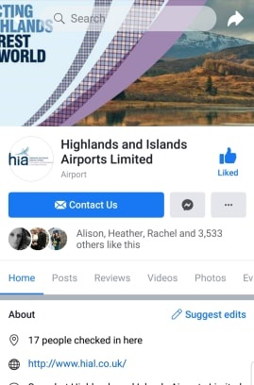
Why text in a banner image doesn’t always work
What you see on your mobile device:
Notes:
On mobile devices (such as phones or tablets) text in cover banners can crop at various points making your text illegible – there are so many screen sizes, ages of device etc that it’s virtually impossible to have text on the far left or right hand side.
There are ways to include text in your banner image but it’s best to keep it centred and concise.

Slide 22
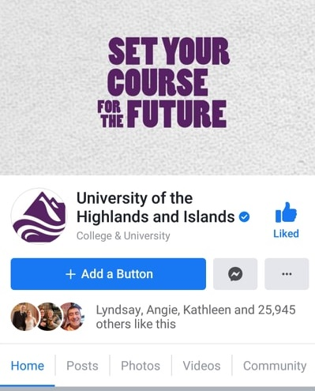
When text does work in a banner
Desktop
Mobile view
Notes:
On mobile devices (such as phones or tablets) text in cover banners can crop at various points making your text illegible – there are so many screen sizes, ages of device etc that it’s virtually impossible to have text on the far left or right hand side.
There are ways to include text in your banner image but it’s best to keep it centred and concise.

Slide 23
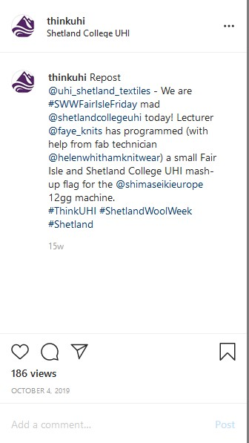
Include photos and videos where you can
Notes:
It’s probably no surprise that the most popular posts have photos.
Videos are also very popular, some stats for you to digest:
Viewers retain 90% of a message when they watch it in a video in comparison to 10% when reading it
93% of mobile videos are shared with others
90% of our brains' messaging is visual. It gets to the brain 60 times quicker!
Sometimes we also source them on Flickr, if they have copyright, we drop the owner an email and explain the purpose which they usually come back and let us know they are happy to use our picture.
There is no need to ask for copyright when you share photos or videos from social media as they are already displayed on a public platform – but it’s always good to acknowledge the user.

Slide 24
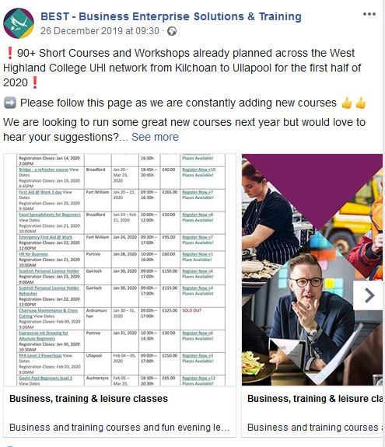
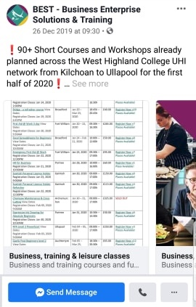
But don’t include heavy text in your image
Desktop view
Mobile view
Notes:
You have a lot of information to share so you decide to create a handy at-a-glance table which you upload to Facebook, Twitter, Instagram etc.
Not only is this incredibly difficult to read it is ILLEGAL!
As an education provider we need to comply with the law in terms of accessibility – this includes both social media and web content.
Why text in images is harmful: the first problem with using an image to show text is it takes away the accessibility for blind and visually impaired users that comes with text. For instance, a blind user might have a screen reader set up on their computer to read out the text and menu items for them. This way they can interact even though they can't see the screen.
What does the reader have read to them in this instance? ‘Image’.
DON’T DO IT! If you have lots of information to share you need to create a webpage and use social media to signpost to it.

Slide 25
Why you should ALSO avoid text in images
Source: https://instapage.com/blog/facebook-20-text-rule
Notes:
If you are looking to run pay-per-click on your Facebook posts, there is rules in place for text in images.
Until recently, Facebook advertisers were allowed to cover their ad images with NO MORE than 20% text.
Under Facebook’s new guidelines, an ad won’t be outright rejected if it contains more than 20% text, but it will have its reach limited — in some cases significantly. Instead of using a “run or reject” system, Facebook will now categorise your ad according to the above ratings.
With Facebook’s new text overlay tool, you can upload an image to see what the chances are it will have its reach restricted: https://www.facebook.com/ads/tools/text_overlay

Slide 26
Looking to run Pay-Per-Click (PPC?)
“You can achieve more with a $500 paid activity than a page with 80 million fans.”
Wes Finley, Global Social Media Marketing Lead;
and former Global Operations Director, Coca-Cola Social Connections
Notes:
Whether you are delving into Pay-Per-Click (PPC) for the first time, or want to know how to use your budget more effectively get in touch!
We have experience of running multiple campaigns across most social media platforms including Facebook, Instagram, Twitter, LinkedIn and YouTube.
Get advice on the most appropriate social media platform for your target audience, the best time to run them and how to track your results.

Slide 27
Mix up your content
Notes:
These show insights into the top ten posts from 23 Aug to 20 Nov.
The interesting point to note here is 6 out of the 10 posts are not university-related.
Furthermore only 1 of the top 5 are university-related/
Number 1 was the ‘Tattie holidays’ post which has hit 30,000 views.
Don’t be disheartened by this information…of course we still want to share our news and events, why else would we be on social media?
Adopt the 30/70 rule – 30% should be about YOUR organisation and 70% should be about your audience and should aim to entertain, educate and inform.

Slide 28
Time your posts
Best days to
post for Facebook and Instagram:
Thursdays
and
Fridays
Best times to
post for UHI:
Weekdays at 1pm and
8pm
Notes:
If you follow the university social media it’s not hard to see a pattern: 2-3 posts a day on weekdays: morning, afternoon and evening and 1 or 2 posts at the weekend in the early afternoon or evening if we have interesting content.
If we want to reach our current students, we tend to post on weekday evenings as this is when they are most likely to be on social media and this tends to be our peak time, particularly between 8pm and 9pm.
If we have an event to promote or perhaps an interesting piece of research the university has been involved in, we post it on weekdays at lunchtime when people log on during their lunch break because again insights tells us this is the 2nd peak time for us.

Slide 29
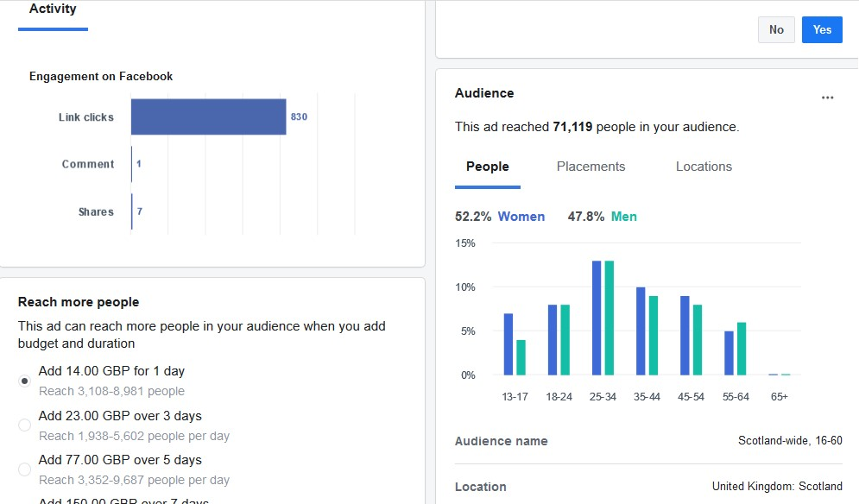
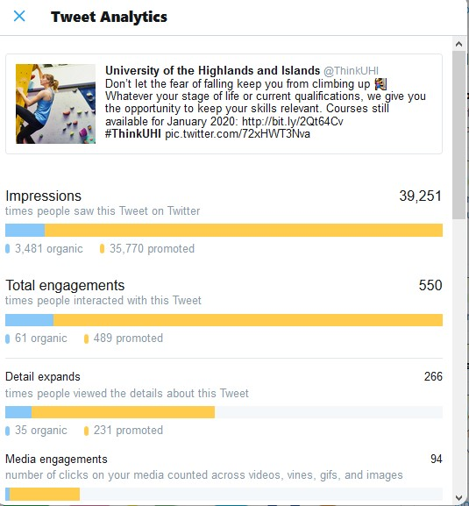
Track your success…and failure
Facebook insights
Twitter insights
Notes:
Most days we have a wee nosy on social media insights and see how we are doing.
Are our posts getting good reach and engagement? Do the demographics match up with our target audience?
We also review our weekly content against previous weeks and see if are keeping up momentum or dropping to gauge whether our content is engaging with our users – this allows us to change it up if not.
It’s easy to get downhearted when you’ve had a massive peak on a post the week before in comparison to your current week but as long as your page Likes steadily increase, people are sharing your posts and engaging with you then you’re still on the right path!

Slide 30
Thank you
Q&A

Slide 31
Sources of information:
https://blog.hootsuite.com/social-media-in-higher-education
https://hootsuite.com/webinars/3-trends-unveiled-in-the-hootsuite-social-campus-report
https://tsrmatters.com/blog/why-brands-essential-for-universities
https://www.forbes.com/sites/forbescommunicationscouncil
https://mediasmart.uk.com/social-media/why-do-teens-love-instagram
https://blog.hootsuite.com/ideal-social-media-post-length
https://instapage.com/blog/facebook-20-text-rule
https://www.facebook.com/ads/tools/text_overlay
https://sproutsocial.com/insights/best-times-to-post-on-social-media/
http://blog.hubspot.com/marketing/how-to-create-facebook-business-page-ht
https://natives.group/en_gb
www.terminalfour.com/blog

Slide 32
Handy sources:
https://www.t4help.uhi.ac.uk/guidance-support/social-media/
https://www.t4help.uhi.ac.uk/media-library/preparing-photos-and-other-images/
https://www.t4help.uhi.ac.uk/media-library/preparing-photos-and-other-images/cropping-and-resizing/
https://www.t4help.uhi.ac.uk/media-library/preparing-photos-and-other-images/choosing-appropriate-images/
Royalty free stock images available to buy (also includes vectors which are text graphics):
https://www.istockphoto.com/gb
https://www.shutterstock.com/home
Royalty free stock images available for free:
https://www.canva.com/photos/free/
https://www.pexels.com/
https://pixabay.com/
https://unsplash.com/
Short URL builder:
https://bitly.com/
Free software to create text graphics, photo collages and posts for social media:
www.canva.com

